Slide 1

HEART DISEASE REFERRAL APPLICATION
FINAL PROJECT
GROUP PRESENTATION
Terryann Barnett
Osman Dumbuya
Michael Roberts
Data Analytics Boot Camp Program
Columbia University School of Engineering
December 14, 2023

Slide 2
INTRODUCTION
This is a supervised machine learning project which uses Python (Pandas, NumPy, Scikit-learn, Flask, Joblib) HTML, CSS, and JavaScript technologies.
The project aims to build a binary classifier, which performs with at least 90% accuracy, to make predictions about the risk of heart disease.
The project features a full stack-front and back end development tools-to create a functional application that satisfies modern industry standards.

Slide 3
BACKGROUND AND PURPOSE
Heart Disease is among the most prevalent chronic diseases in the United States.
It claims roughly 647,000 lives each year!
Nucare Health Insurance Company is concerned about 2 phenomena which occurred in 2015:
(i) 80% of their cardiovascular specialist referrals were for cases that had low risk
for heart disease.
(ii) The expenditures for Cardiologist specialist care was 40% more than the previous year.
The National Health Insurance Equity Board is looking to lower the number of “No Referral Needed from Primary Care” appointments to make more spots available to patients who need them the most.
Our organization is contracted to develop an application which can be used as a baseline that primary care doctors can use to generate a code to make a referral to a cardiologist.

Slide 4
FEATURES
ETL
RANDOM FOREST BINARY CLASSIFIER
BACKEND DEVELOPMENT
FRONT END DEVELOPMENT

Slide 5
WORKFLOW: Extract, Transform, and Load (ETL)
Convert 500mb size dataset of more than 300 columns and 440k rows to 67k columns and 14 rows
Utilized dataset documentation (Codebook) and advise of medical clinician to determine columns in the dataset that illustrated health conditions that correlate strongly with heart disease
Rename columns to make them more readable and drop data rows with null (empty) values
Ensure that columns had binary values (0 or 1) to match expected input data
Separate the dataset into labels (heart disease) and features (13 categories) in preparation to develop training and testing data to use with a Binary Classifier Model

Slide 6
WORKFLOW: Binary Classifier Model Build
The Random Forest Classifier Model (RFCM)
Meaning: Is a machine learning algorithm used to predict patients whom are at risk of heart disease using the train dataset.
How it Works: the algorithm randomly selects different subsets from the train dataset and create a decision tree from each subset, and RF grows into multiple decision tree. Each decision tree makes unique prediction (Bootstrap) and the algorithm combines the predictions of the multiple decision trees to predict the class of the dataset. The target variable (y) is called class.
Model Evaluation: the classification report analyzes model’s performance for each class as well as overall metrics

Slide 7
WORKFLOW: Binary Classifier Model Build - EVALUATION
Balanced Accuracy: 0.8461485786755695
 | PRECISION | RECALL | F1-SCORE | SUPPORT
LOW RISK | .93 | .99 | .96 | 10767
HIGH RISK | .96 | .70 | .81 | 2794
ACCURACY |  |  | .93 | 13561
MACRO AVG | .94 | .85 | .88 | 13561
WEIGHTED AVG | .93 | .93 | .93 | 13561

Slide 8
MODEL ANALYSIS
94% ACCURACY-only 6% of all predictions of both classes are incorrect
Low Risk: 0.93 Precision-is not correct only 7% of the time when low risk is predicted
1.00 Recall-correctly identifies 100% of all instances of low risk
High Risk: 1.00 Precision-is 100% correct when high risk is predicted
0.70 Recall-misses 30% of the instances of high risk
Recommendation: The physician considers prevalence and presenting clinical data

Slide 9

WORKFLOW: FLASK SERVER
Set up Flask
Load the Random Forest model with Joblib load method
Define a function to preprocess the input data from the formWizard
Define the home route to render the index.html to receive input data
Define the prediction route with POST method to submit data to be processed
Ensure that preprocessing creates an array and processing creates a dictionary (request.form.to_dict)
Random Forest model’s predict method makes the prediction
result.html is rendered with the appropriate message

Slide 10

WORKFLOW: HTML/JavaScript
index.html
Set up head with CSS Link
Set up navbar with container for buttons to navigate to external sites
Div for the formWizard being careful with setting up the form steps and button functionality and also turning of the auto-complete dropdown to avoid crowding and input errors
Script tag for jQuery for document traversal/functionality/event handling
JavaScript code to handle the form steps

Slide 11
WORKFLOW: HTML/JavaScript
result.html
Set up head with CSS link
Set up navbar with container for buttons to navigate to external sites
Div for the prediction which includes if...else…endif and the statements to be printed when a condition is met

Slide 12

WORKFLOW: CSS
index_style.css/result_style.css: scripts provide styling for the index.html and result.html
navbar: with title and functioning buttons
body: background picture with no repeat
formWizard: size, position, padding, linear gradient color, shadow

Slide 13
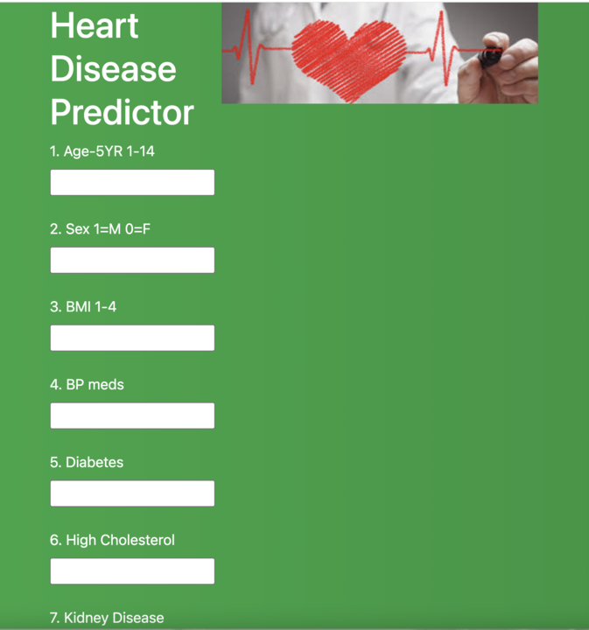
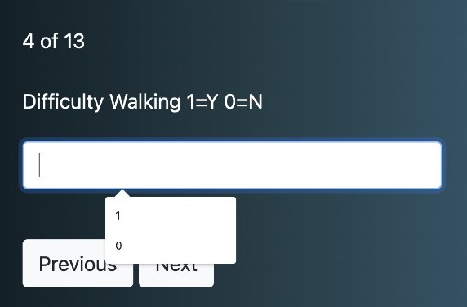
KEY CHALLENGES
DATA ANALYSIS
Large Data Set (440,000 rows by 330 columns
Domain Knowledge - BRFSS Codebook/clinician feedback
Locate and remove nulls/missing values/blanks/extraneous data
DATA SCIENCE
Encoding: Binary structure of 1 & 2/Categorical coding (0 to 14) for BMI and age/Extraneous values (7 and 9)
Logistic Regression Model not converging
Weakness in model especially High Risk recall score persists at 70%
WEB DEVELOPMENT
Flask (return.html) failure
Navigation Bar
formWizard
USER EXPERIENCE
Modern
Interactive
One-page vs carousel
Turn off auto complete
Links

Slide 14
RECOMMENDATIONS FOR IMPROVEMENT
Leverage feature engineering
Optimize the model (SVM, Keras Tuner, TensorFlow)
Train the model on a larger data set
Develop application for mobile devices
Develop application for patient use

Slide 15
LIVE DEMONSTRATION OF THE APPLICATION!
Terryann: Project Structure
Michael: formWizard
Osman: OnClickSubmit

Slide 16
REFERENCES
Kaggle Dataset: Behavioral Risk Factor Surveillance System (2015)
https://www.kaggle.com/datasets/cdc/behavioral-risk-factor-surveillance-system?select=2015.csv
Behavioral Risk Factor Surveillance System 2015 Codebook Report
https://www.cdc.gov/brfss/annual_data/2015/pdf/codebook15_llcp.pdf

Slide 17

QUESTIONS/COMMENTS

